Slide 1




HackOrbit 2025
TechnoCrats

Slide 2

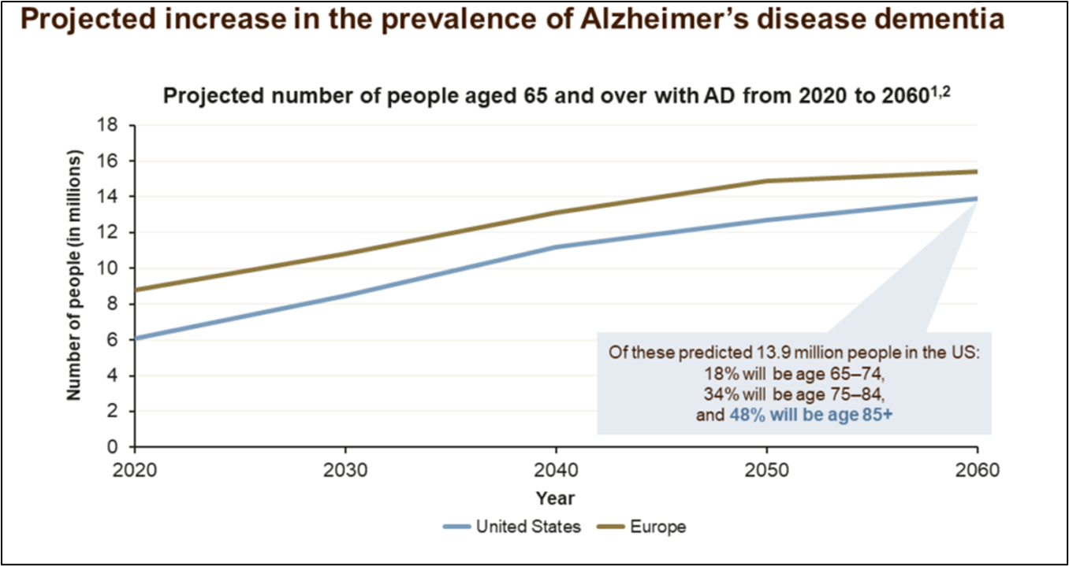
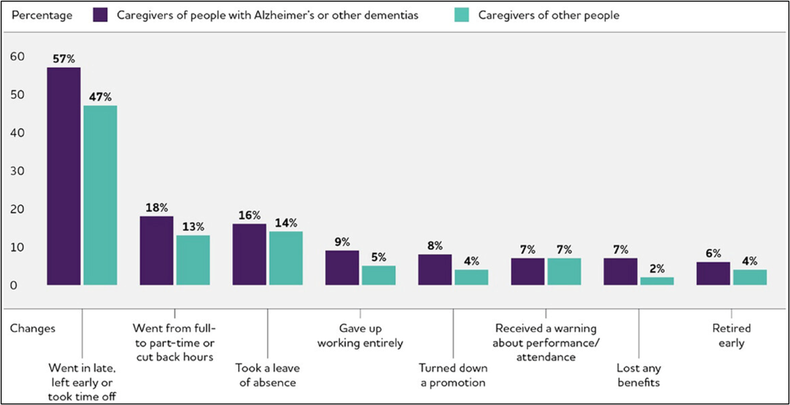
THEME & PROBLEM STATEMENT
Theme: Artificial Intelligence and Machine Learning
The Challenge: Alzheimer’s & Daily Activities​
🔹 Alzheimer’s patients struggle with daily tasks (e.g., eating, dressing, hygiene).​
🔹 Memory loss & confusion lead to missed medications, wandering, and falls.​
🔹 Caregivers face high stress due to constant supervision needs.​
​
Limitations of Existing Solutions​
🔹 CCTV & manual monitoring → Not scalable, lacks real-time intervention​
🔹 Smart home devices → Cannot differentiate similar activities accurately​
🔹 AI-based models → Trained on healthy individuals, ineffective for patients with irregular movements.​
​

Slide 3
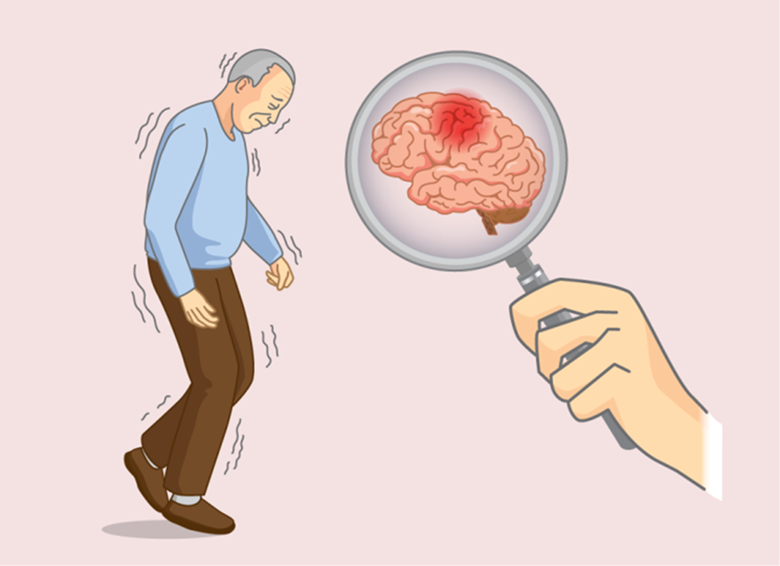
PROPOSED SOLUTION
A non-intrusive, AI-powered Human Activity Recognition (HAR) system using CNN, LSTM, Random Forest, and MediaPipe Pose.
Enables real-time activity prediction (e.g., walking, sitting, standing) and abnormal behavior detection such as falls or prolonged inactivity.
Sends instant alerts via SMS and email to caregivers and healthcare professionals for timely intervention.
Provides a lightweight, cost-effective Android application with a minimalist UI for easy deployment on standard smartphones.
Logs daily activity data and includes cognitive games to support patient engagement and caregiver assistance.

Slide 4
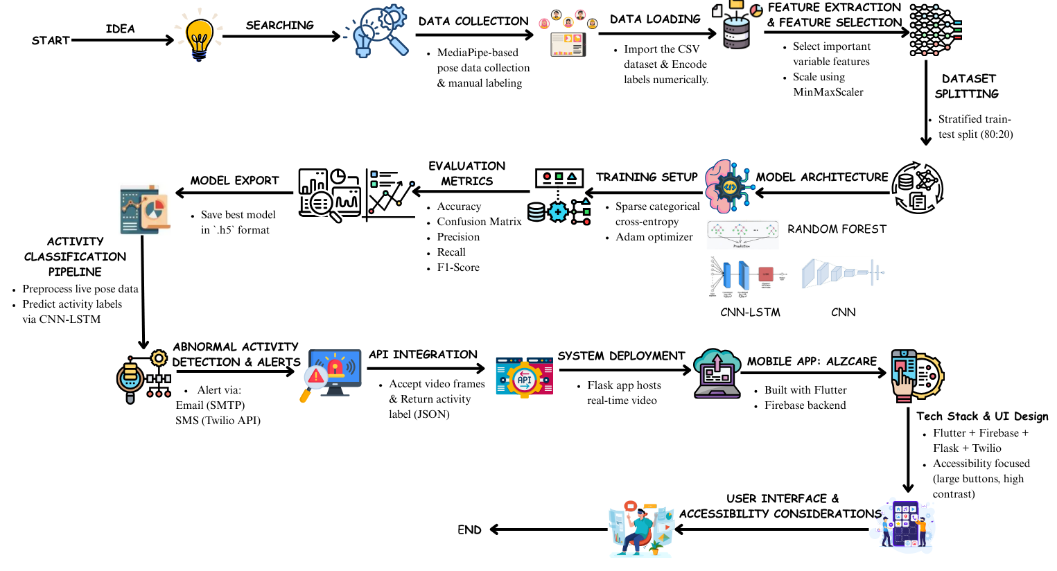
PROPOSED METHODOLOGY

Slide 5
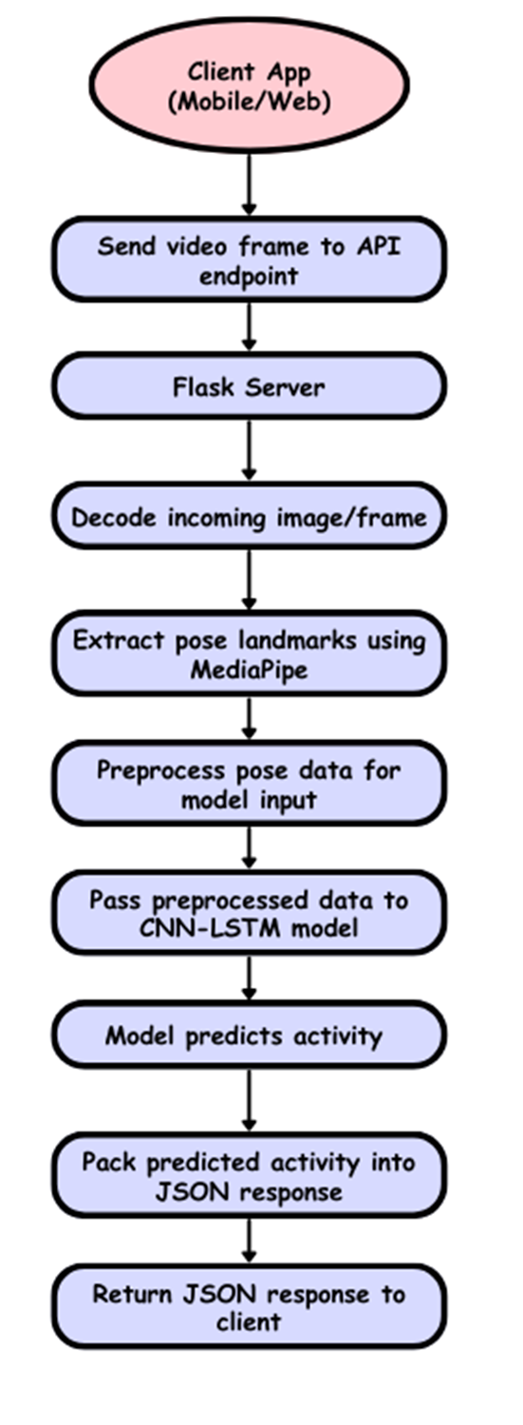
How Data Was Recorded?
Remote Human Activity Prediction Workflow
Live Video Feed:
Captured using webcam via OpenCV.
Pose Detection with MediaPipe:
MediaPipe Pose uses 33 Key Body Landmarks, such as:
1. Head & Face: Nose, left eye, right eye, left ear, right ear
2. Torso: Left shoulder, right shoulder, left hip, right hip
3. Arms: Left elbow, right elbow, left wrist, right wrist, etc.
4. Legs: Left knee, right knee, left ankle, right ankle, etc.
5. Feet & Hands: Left heel, right heel, left index, right index, etc.
Each frame is processed to extract:
33 body landmarks: (x, y, z) coordinates + visibility.
33 landmarks × 4 values = 132 feature
This diagram illustrates the workflow of a real-time human activity recognition system designed for mobile and web platforms. The client application captures and sends video frames to a Flask-based API server. The server decodes the frames and uses MediaPipe to extract pose landmarks. These landmarks are preprocessed and fed into a CNN-LSTM model, which analyzes spatial and temporal features to predict the user's activity. The predicted activity is then formatted into a JSON response and returned to the client for further use, such as alert generation or activity tracking.

Slide 6
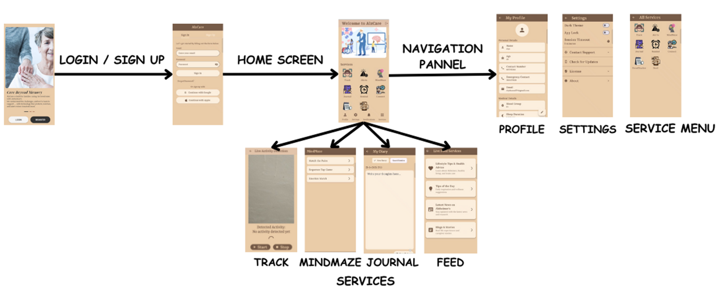
MOBILE APPLICATION FLOW
*What is AlzCare?
A mobile app that supports Alzheimer’s patients and caregivers with AI-powered monitoring, mental stimulation, and daily care tools — all in one clean interface.
Key Features:
🧠Live Activity Detection (AI-based abnormal behavior detection)
📩Real-time Alerts via SMS/Email
🎮MindMaze Cognitive Games (Memory, Focus, Emotion Matching)
📝 Daily Journal (Mental wellness logging)
🕒 Reminders & Routines (Medication, tasks)
❤ Wellness Feed (Tips, stories, advice)
TECH STACK :
Flutter
Firebase
AI (CNN-LSTM + MediaPipe)
Twilio/SMTP for alerts

Slide 7
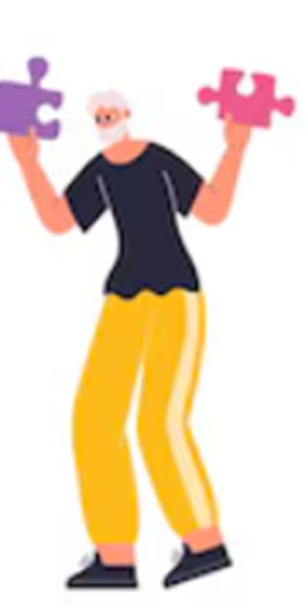
FEATURES AND NOVELTY
Hybrid Model Integration: Uses a combination of CNN, LSTM, and Random Forest with MediaPipe Pose for accurate real-time human activity recognition from standard video input.
Anomaly & Fall Detection: Identifies falls, prolonged inactivity, and unusual movements, triggering immediate alerts to caregivers.
Real-Time Monitoring Dashboard: Displays live activity labels (e.g., walking, sitting) with confidence levels and visual alerts.
Emergency Contact Integration: Automatically notifies and allows quick calling of emergency contacts during critical events.
Activity Logging: Maintains daily logs of detected activities for caregiver review and pattern tracking.
Mindful Game Module: Offers simple cognitive games to help patients stay mentally engaged.
Lightweight Android App: Minimalist UI ensures smooth performance across various devices, designed for elderly users.
Low-Latency AI Processing: Ensures fast pose estimation and alerting using optimized lightweight models.

Slide 8
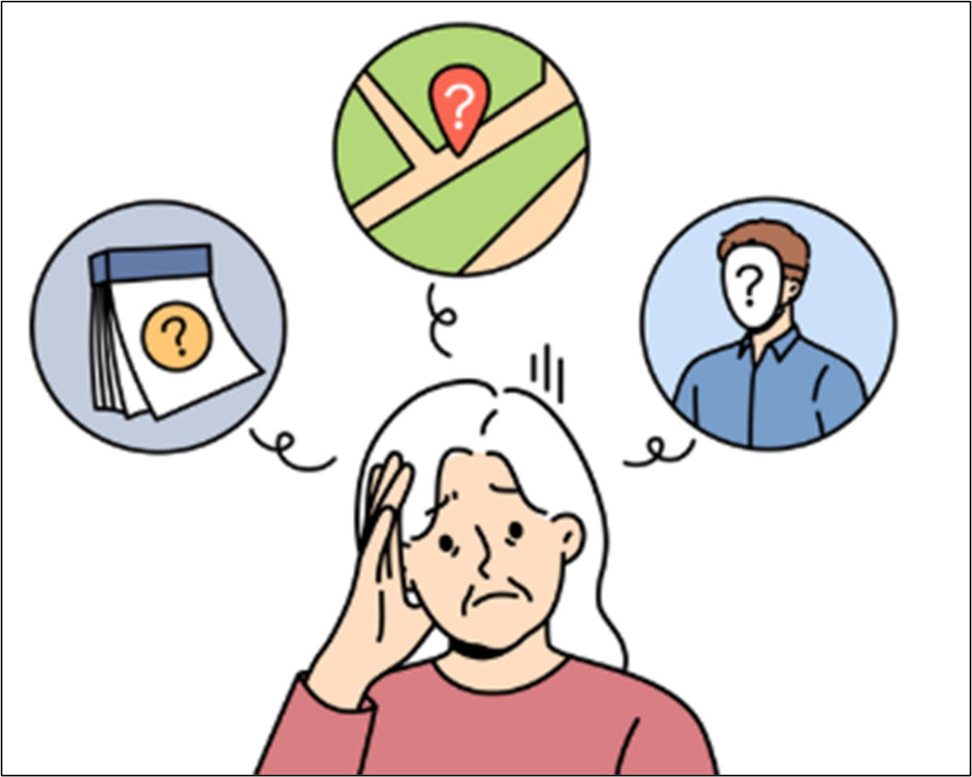
DRAWBACK AND SHOWSTOPPERS
Drawbacks:
Limited Accuracy: Possible misclassification (e.g., sitting vs. lying).
Tech Dependency: Needs reliable internet & device uptime.
Privacy Concerns: Continuous monitoring may violate personal privacy.
High Cost: Smart devices & infrastructure may be expensive.
Showstoppers:
🚫 No patient/guardian consent
🚫 System failure during emergencies
🚫 Legal non-compliance (HIPAA/GDPR)

Slide 9
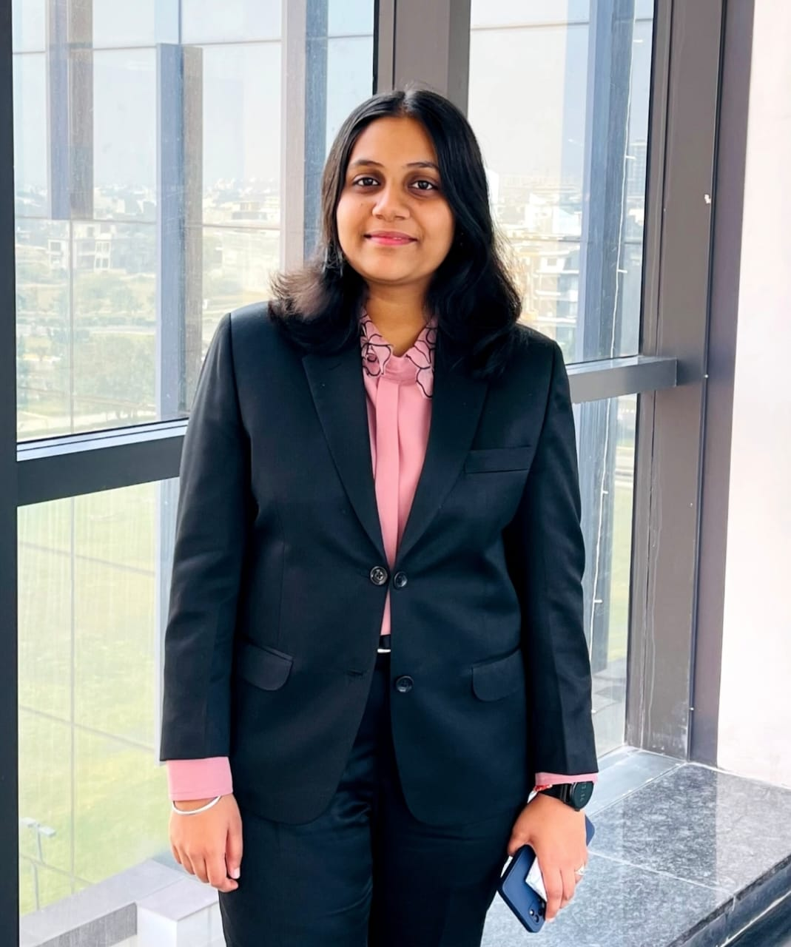
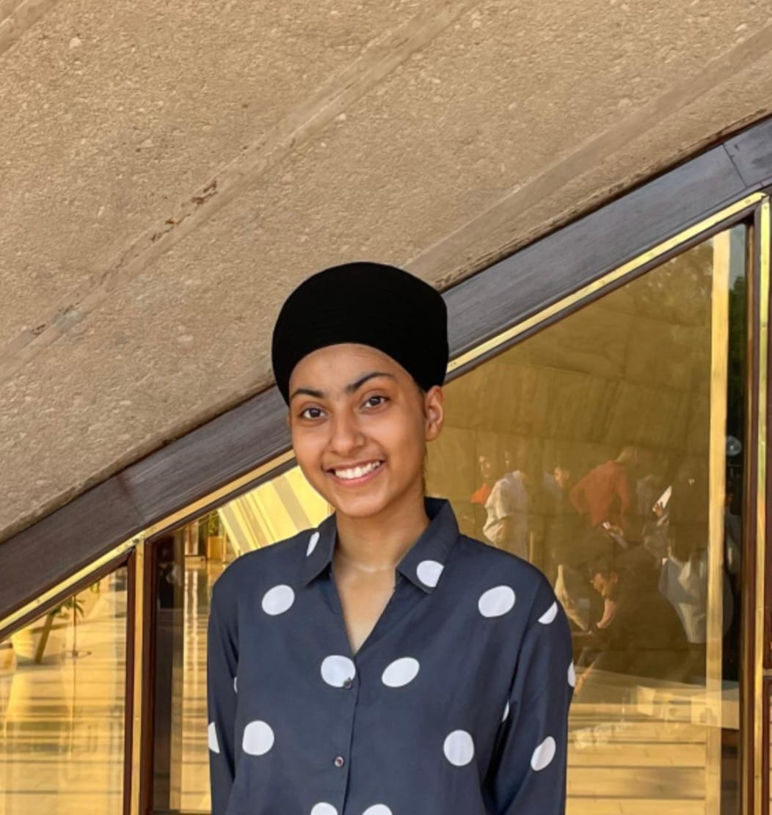
TECHNOCRATS
RIYA KANSAL
(UI/UX Developer)
riyakansal174@gmail.com
+91 7652973801
JAPPANJOT KAUR
(Backend Developer )
jappanjotkaur2004@gmail.com
+91 9555961963

Slide 10
Thank you

